Slide 1


RECIPE INGREDIENT EXTRACTION
SEMINAR ENDTERM PRESENTATION

Slide 2



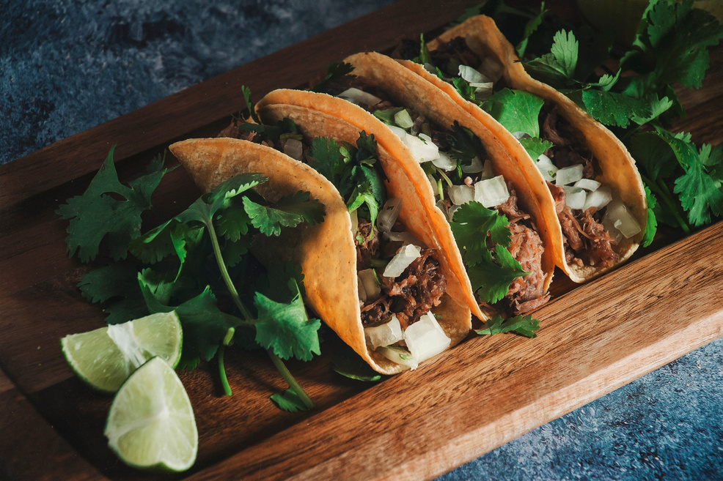

Introduction
CuliClassify - Recipe ingredient extraction is an essential task in food technology and culinary applications. With the rise of online recipes, many lack structured ingredient lists, making it difficult for users to identify necessary components. Machine Learning (ML) and Natural Language Processing (NLP) help automate this process by using techniques like tokenization, part-of- speech (POS) tagging, and named entity recognition (NER). This study explores these techniques to enhance accuracy and scalability in extracting structured ingredient information from unstructured data sources.

Slide 3


2. Background/Motivation
The need for structured ingredient extraction arises from the increasing reliance on online recipes, where ingredient lists are often missing or complex. Many individuals, especially beginners, find it challenging to identify ingredients just by reading a recipe. Traditional rule-based approaches struggle with inconsistencies in ingredient naming and measurement formats. By leveraging AI-driven solutions, ingredient extraction becomes more accurate, facilitating applications in grocery shopping, meal planning, and food analysis.

Slide 4

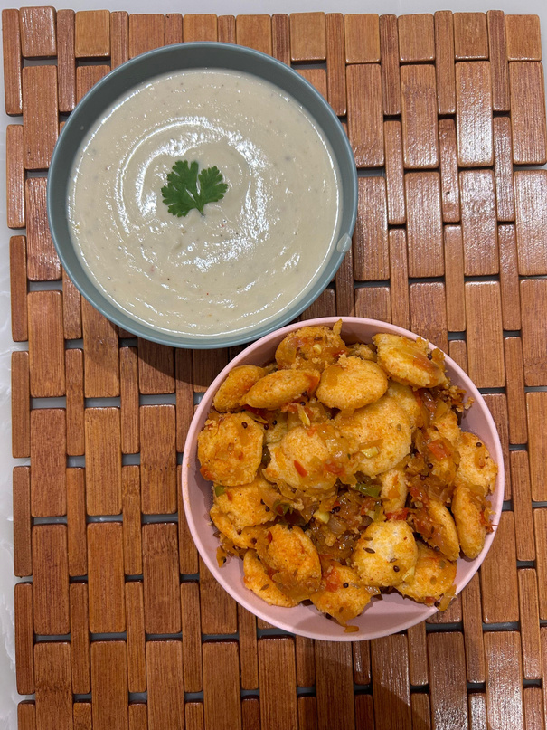

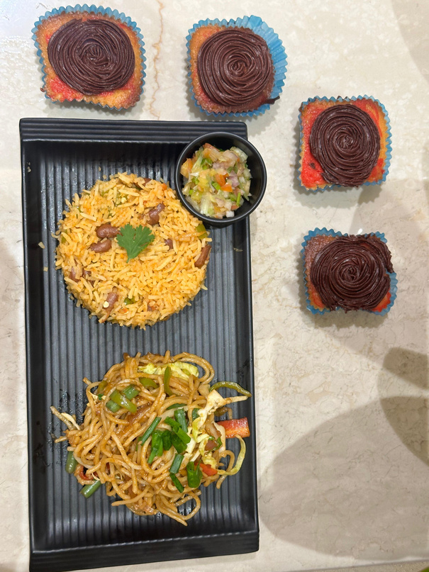
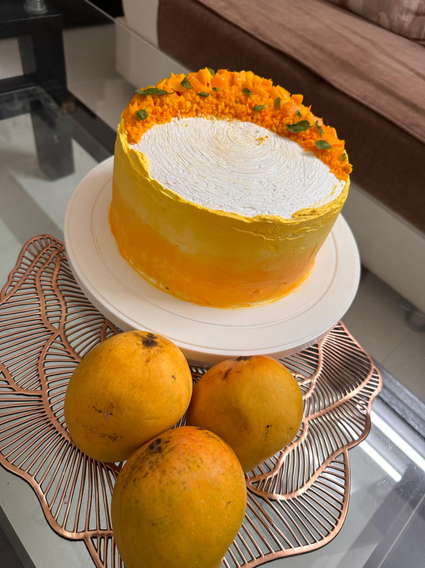

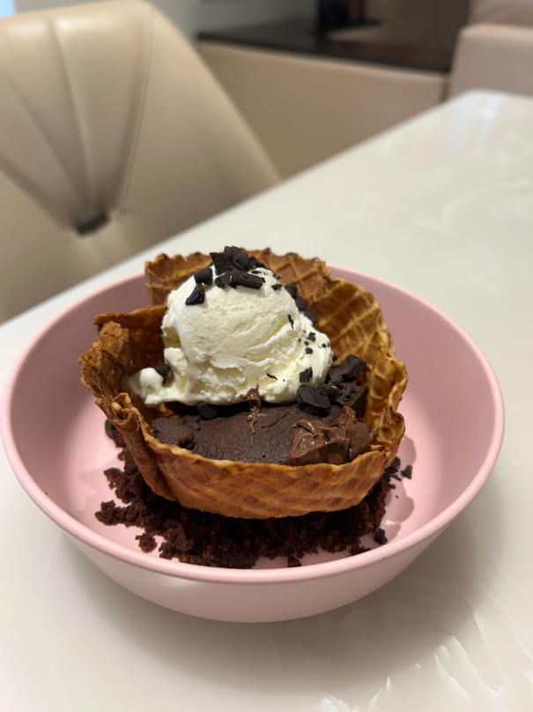
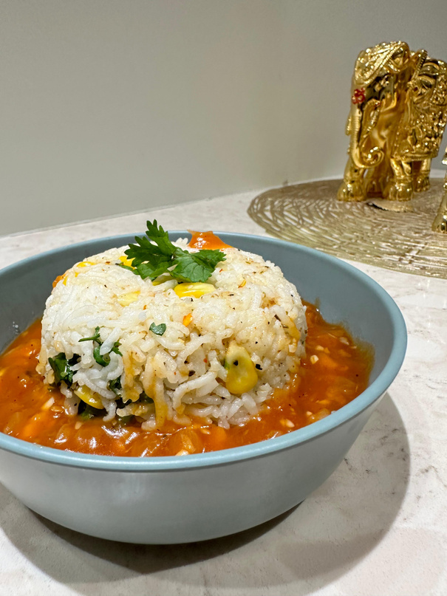

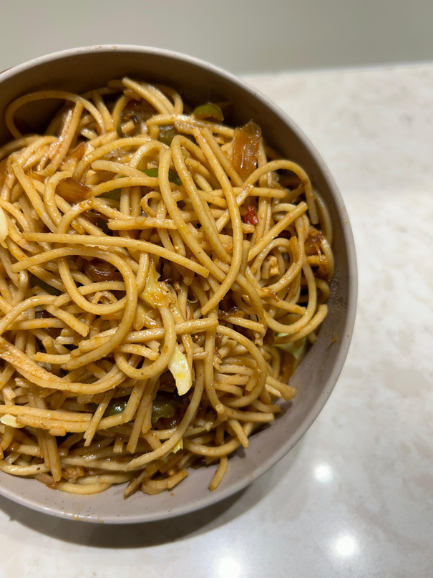
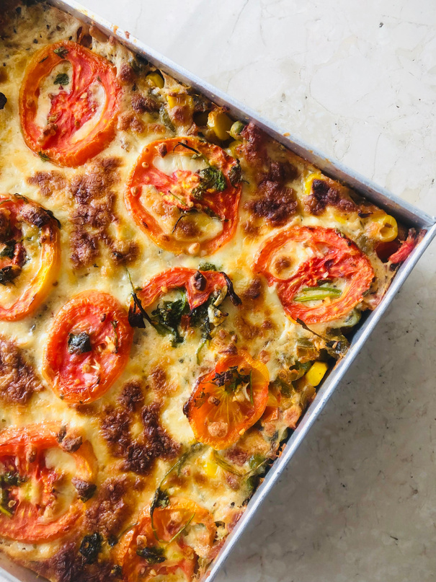

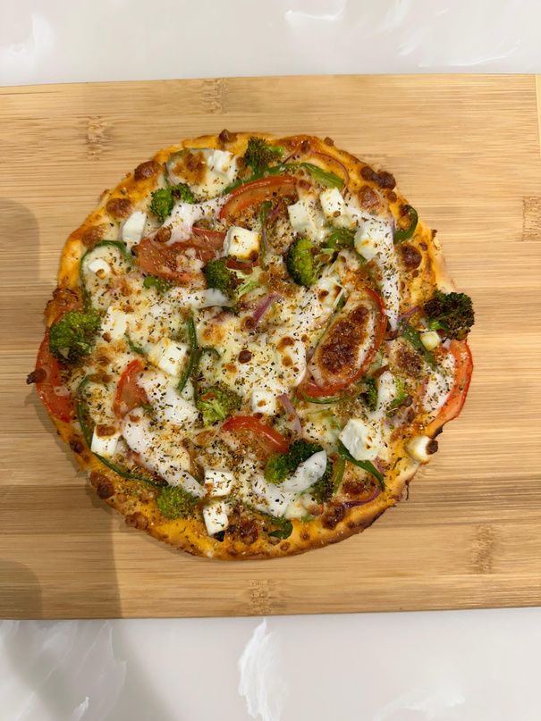

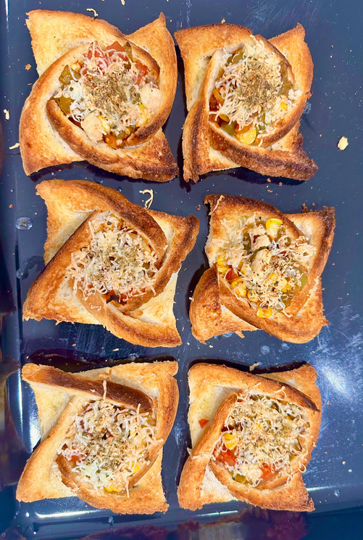
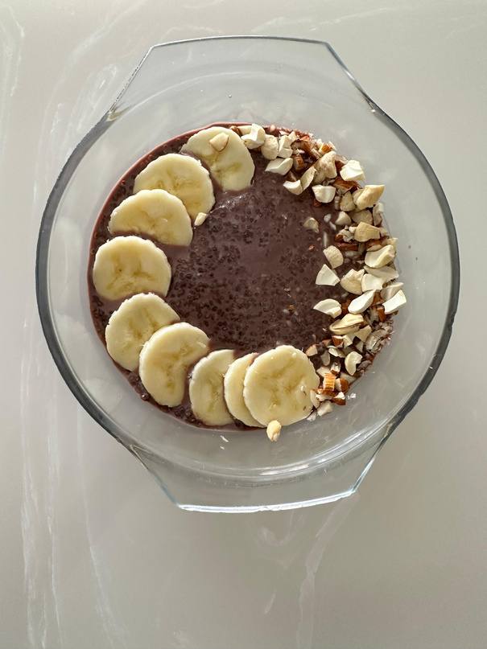
2. Background/Motivation

Slide 5


3. Literature Review
Existing research on recipe ingredient extraction primarily focuses on rule-based systems and keyword identification, which often fail to generalize across different recipe formats. NLP techniques such as tokenization, POS tagging, and Named Entity Recognition (NER) have improved accuracy by understanding linguistic patterns. Machine learning models, particularly supervised learning methods trained on labeled datasets, further enhance extraction performance. Additionally, food ontologies have been proposed to classify extracted ingredients into meaningful categories, improving retrieval efficiency.

Slide 6





3. Literature Review
Information Extraction from Unstructured Recipe Data Nuno Silva, David Ribeiro, Liliana Ferreira
FRIES is a rule-based system that extracts structured data from online food recipes, including ingredient names, quantities, units, and cooking methods. It achieves high accuracy and aids in improving nutritional estimation and personalized recipe recommendations.
Learning to Substitute Ingredients in Recipes Bahare Fatemi, Quentin Duval, Rohit Girdhar
GISMo is a graph-based model designed for recipe personalization through ingredient substitution. It outperforms baselines by using recipe context and ingredient relationships, enabling dietary customization and enhancing image-to-recipe systems for personalized cooking experiences.
Ingredient Extraction from Text in the Recipe Domain. Arkin Dharawat,Chris Doan
The project focuses on extracting ingredients from voice assistant queries using fine-tuned BERT. It achieved a high F1-score of 95.01, highlighting its effectiveness in understanding recipe-related user utterances. The code is publicly available on GitHub.
DeepRecipes: Exploring Massive Online Recipes and Recovering Food Ingredient Amounts KEQUAN LI 1,YANCHEN
DeepRecipes is a predictive model that estimates ingredient amounts from recipe names and ingredient lists. Trained on a small dataset, it outperforms ten baseline models and provides accurate estimates(95%), aiding food-oriented health systems with ingredient quantity data.

Slide 7
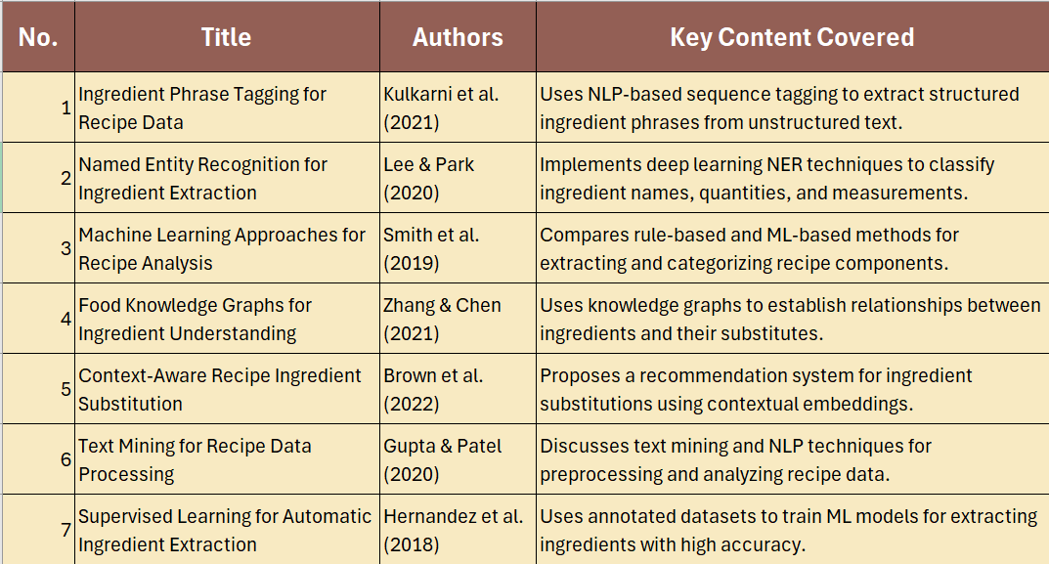

Slide 8



4.Research Gap
Despite advancements, challenges remain in standardizing ingredient names, differentiating between cooking actions and food components, and handling variations in textual formats. Ambiguous ingredient names, such as ‘chili’ referring to both a spice and a vegetable, complicate extraction. Additionally, there is a lack of AI-driven solutions for automatic ingredient substitution. Addressing these gaps through more sophisticated NLP techniques and integrating domain-specific ontologies can significantly enhance ingredient extraction systems.

Slide 9
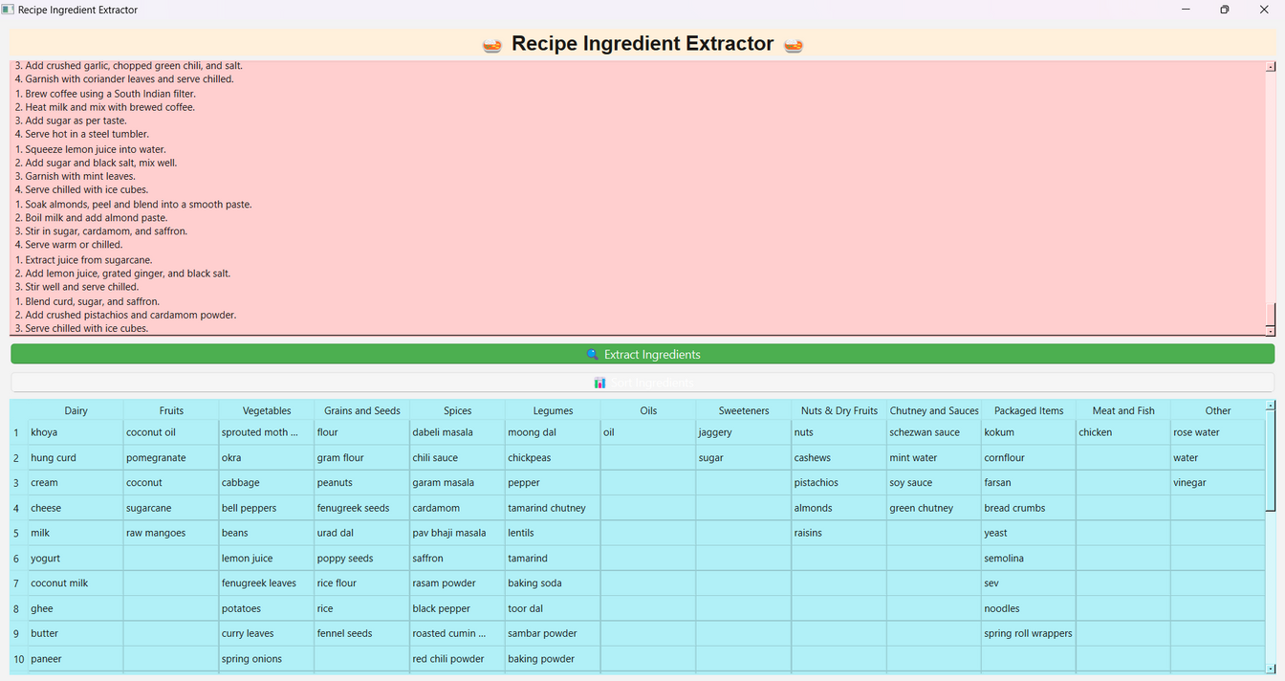
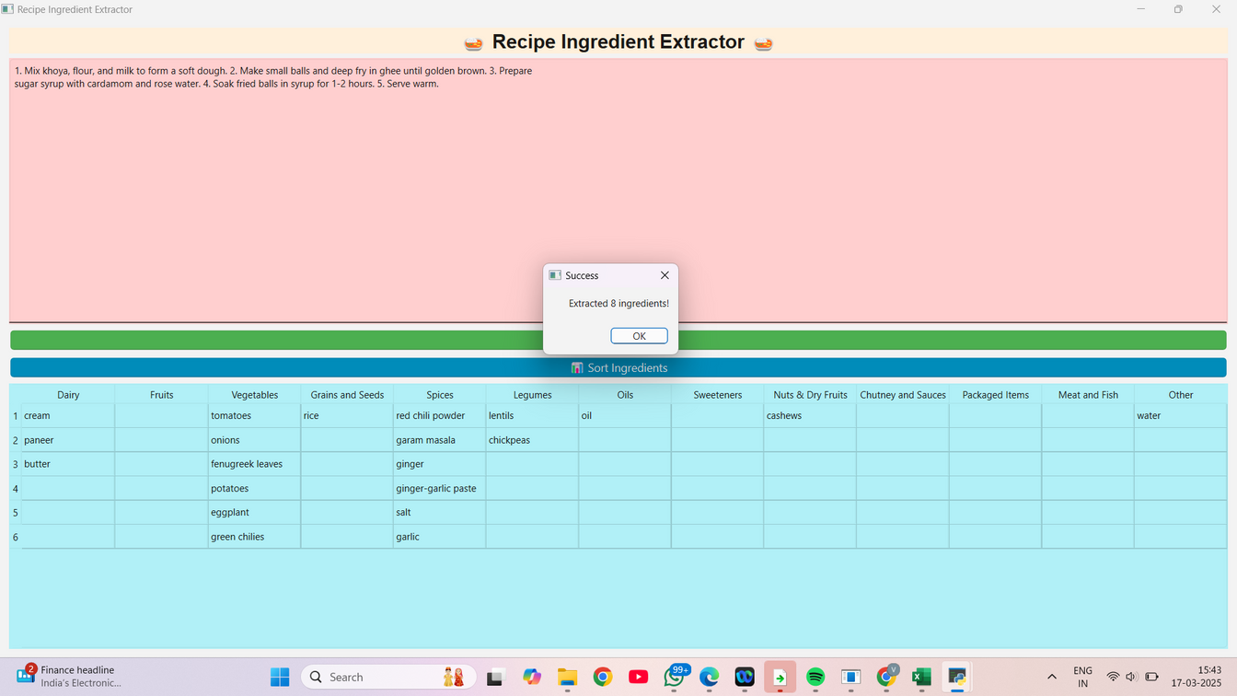
5.Implementation

Slide 10
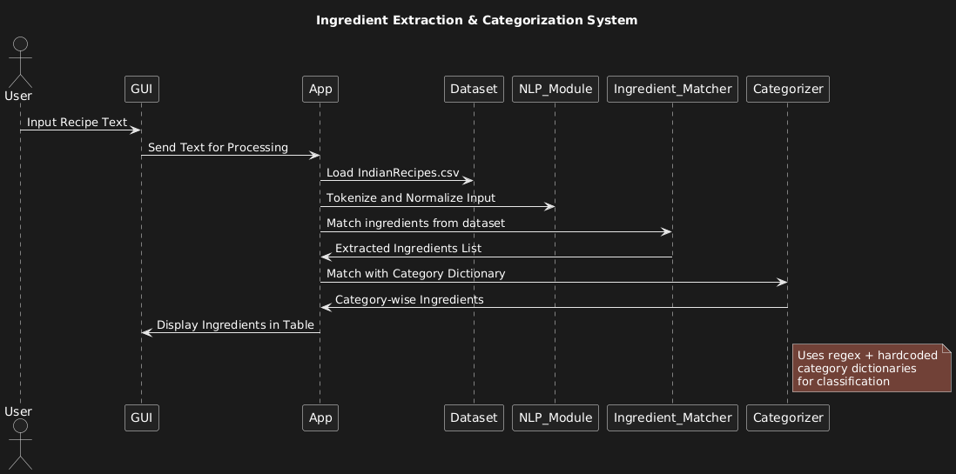
5.Implementation

Slide 11
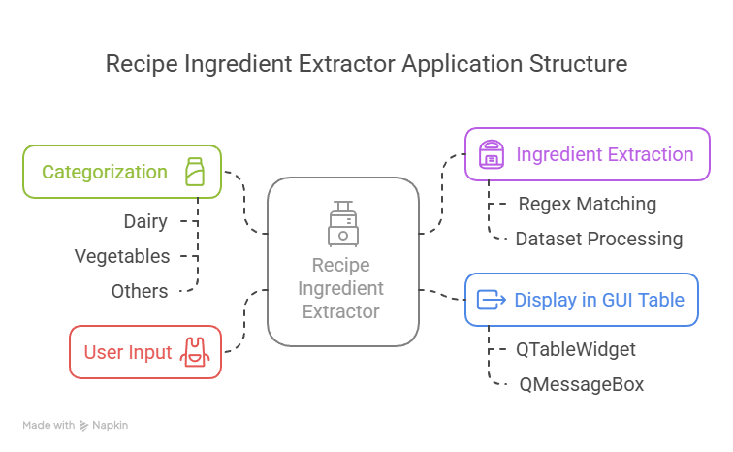
6.Technologies Used
• "Recipe Ingredient Extractor" is a desktop-based GUI application built using Python and PyQt6.
• It allows users to input Indian vegetarian recipes and automatically detects ingredients from the recipe text.
• The application uses the `pandas` library to load and manage a dataset (`IndianRecipes.csv`) of known ingredients.
• Regular expressions (regex) are used to match ingredients accurately within the free-form recipe text.
• Extracted ingredients are then categorized into meaningful groups like Dairy, Vegetables, Spices, etc., using a predefined dictionary.
• The final results are displayed in a colorful table (`QTableWidget`) for better visualization and interpretation.
• The app features a responsive UI with status messages, text input, and action buttons, making it user-friendly and interactive.

Slide 12


7.Pros and Cons
Cons: The approach requires large labeled datasets for training, making implementation challenging. Handling ingredient variations across different cultures and languages adds complexity. Additionally, deep learning models demand high computational resources, making them less accessible for real-time applications. Overcoming these limitations requires further refinement of AI models.
Pros: AI-driven ingredient extraction automates the identification process, reducing human effort and errors. It enhances user experience by providing structured ingredient lists, which help in grocery shopping and meal planning. Machine learning models improve accuracy beyond traditional rule-based systems, making extraction scalable and efficient.

Slide 13



8.Applications
Smart Cooking Assistants
Personalized Nutrition
Grocery Shopping Optimization
Food Industry Analytics

Slide 14









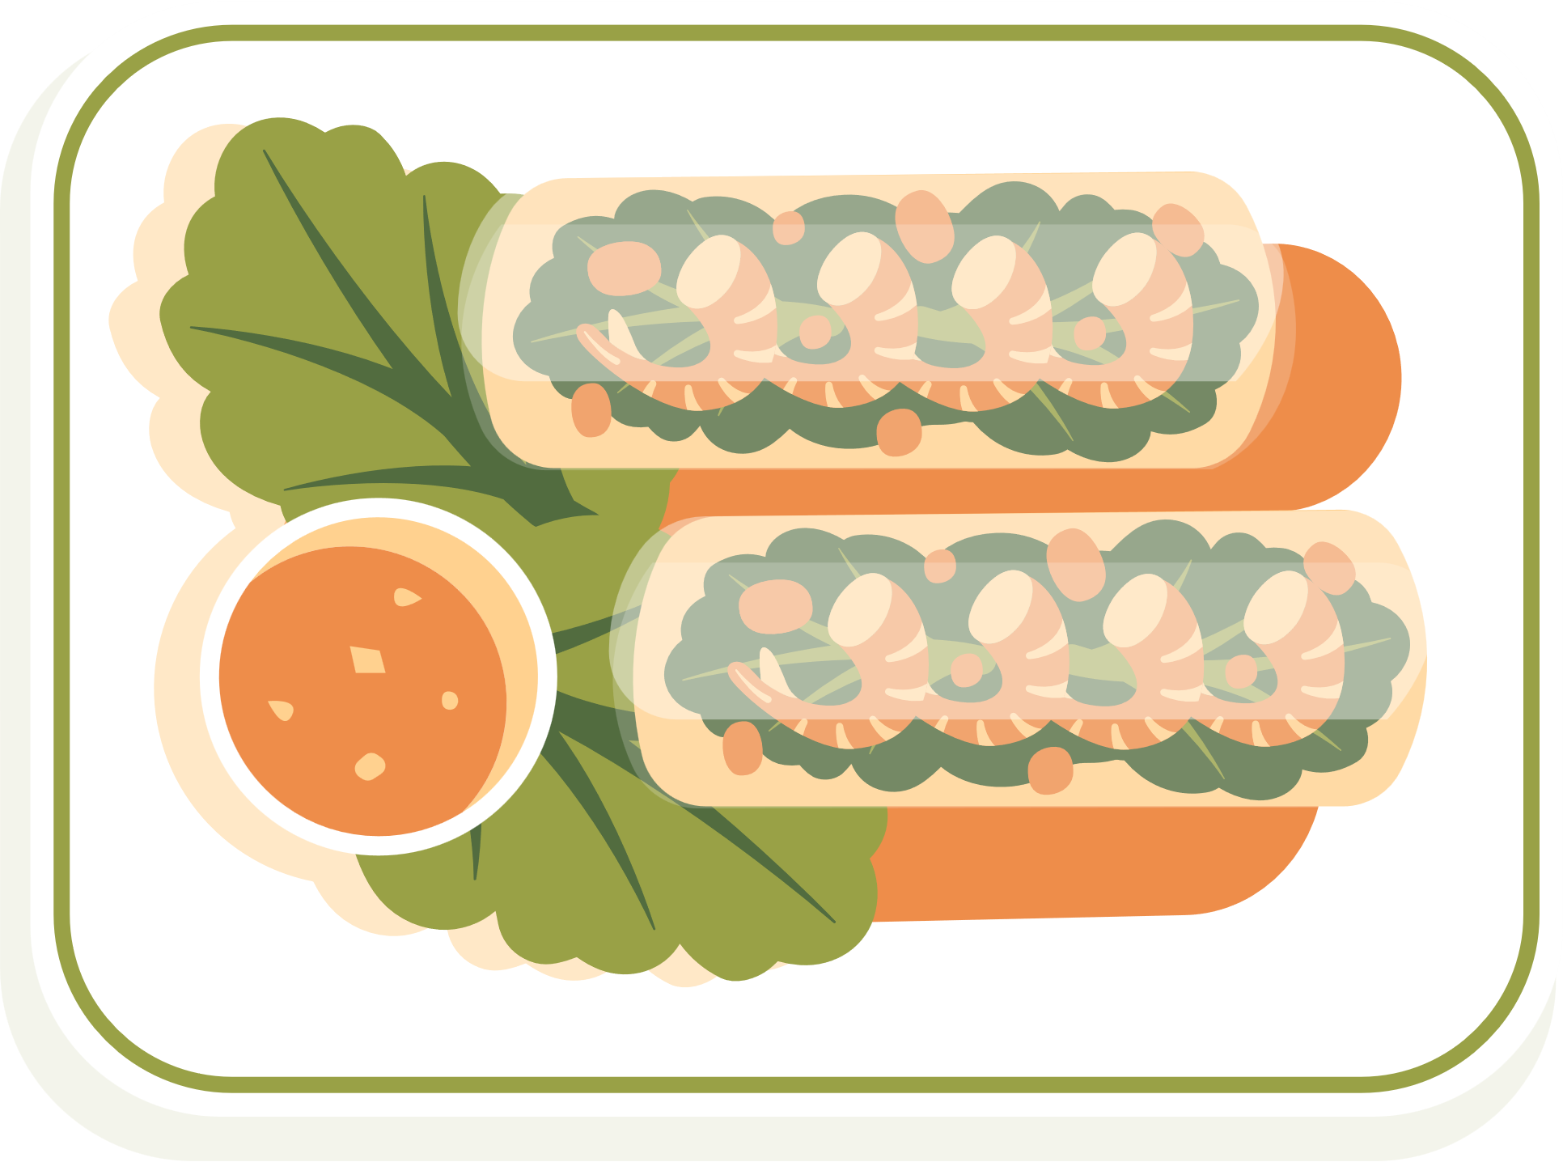
9. Future Scope
The future scope of this ingredient extraction system lies in enhancing its intelligence by integrating advanced NLP models like BERT or GPT-based embeddings for improved context understanding. Incorporating domain-specific ontologies and multilingual support can broaden usability across cuisines and regions. The system can be extended to suggest healthier ingredient alternatives based on user preferences or dietary restrictions. Integration with grocery APIs for real-time pricing, availability, and smart kitchen devices can also enable personalized meal planning, contributing significantly to health, nutrition, and convenience in modern culinary experiences.
Japan
Italy
Mexico

Slide 15





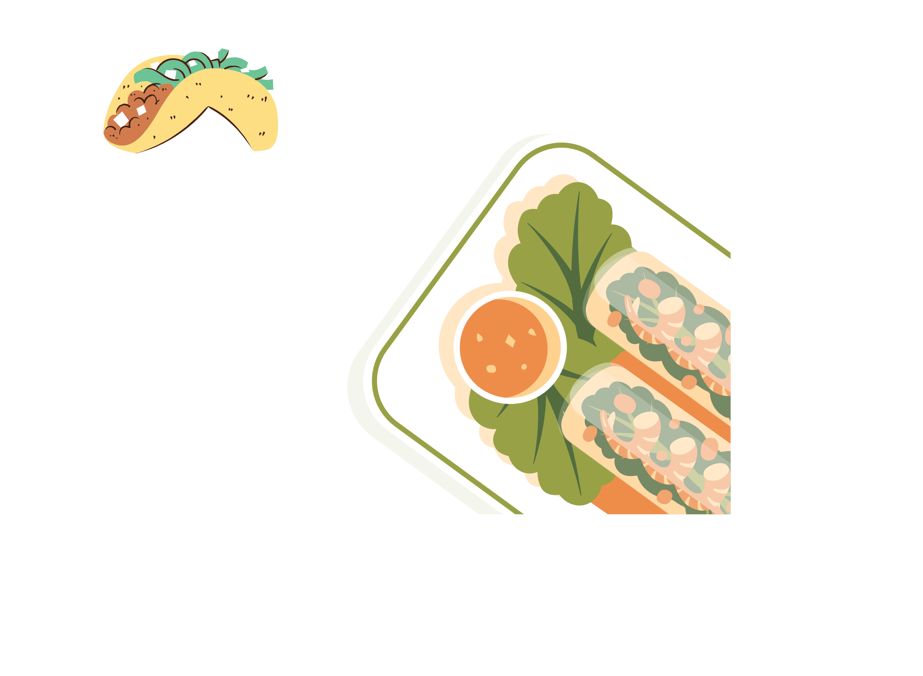

10.Conclusion
This study highlights the potential of NLP and ML in revolutionizing ingredient extraction. AI-powered solutions offer improved accuracy, scalability, and usability compared to traditional methods. The findings indicate a significant impact on food technology, from enhancing culinary experiences to optimizing industrial food processes. Future research should focus on integrating food ontologies, improving multilingual extraction capabilities, and refining AI-driven ingredient substitution techniques. These advancements will further bridge the gap between unstructured recipe data and structured ingredient information.
Japan
Italy
Mexico

Slide 16

PRESENTATION BY: VAIDEHI PADMAWAR TY BTECH CSE PANEL D PD-18 1032222362

